Slide 1
K- Nearest Neighbours (KNN)

Slide 2
Learning Objectives
Introduction to KNN
Euclidian Distance
Determine K neighbours
Approach to find Nearest Neighbours
Pros and Cons of KNN
Hands on exercise on KNN
Case Study
2

Slide 3
Introduction to KNN
It is an instance-based method for predicting class or value of a given query.
Classification is computed from a simple majority vote of the nearest neighbours of each point.
Not suited if the data is noisy and the target classes do not have clear demarcation in terms of attribute values.

Slide 4
Euclidian Distance
The training data is represented by the scattered data points in the feature space.
The colour of the data points indicate the class they belong to.
The grey point is the query point who's class has to be fixed

Slide 5
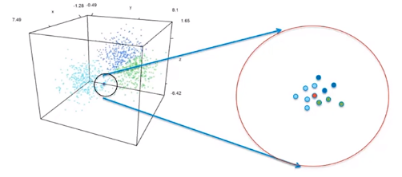
Euclidian Distance

Slide 6
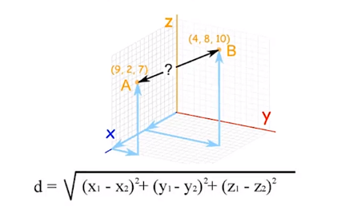
Euclidian Distance
Measuring similarity with distance between the points using Euclidian method.

Slide 7
Determine K neighbours
Scikit-learn implements two different nearest neighbours classifiers – K Nearest Neighbour Classifier and Radius Neighbour Classifier.
Radius Neighbour Classifier implements learning based on number of neighbours within a fixed radius r of each training point.
Determining the optimal K is a challenge. In general, larger value of K suppresses impact of noise but prone to majority class dominating.

Slide 8
Approach to find Nearest Neighbours
The approach to find nearest neighbours using distance between the query point and all other points is called the brute force.
KD tree based nearest neighbour approach helps reduce the time from the order of N^2 to DNlogN where D is number of dimensions.
The distance formula is highly dependent on how features/attributes are measured.

Slide 9

Approach to find Nearest Neighbours
Those dimensions which have larger possible range of values will dominate the result of the distance calculation using Euclidian formula.
To ensure all the dimensions have similar scale, we normalize the data on all the dimensions/ attributes.
There are multiple ways of normalizing the data. We will use Z-score standardization.

Slide 10
Choosing k
higher values of k provide smoothing
reduces the risk of overfitting due to noise in the training data
If k is too low, we may be fitting to the noise in the data
if k is too high, we will miss out on the method’s ability to capture the local structure in the data, one of its main advantages.
In the extreme, k = n = the number of records in the training dataset - all records to the majority class in the training data

Slide 11
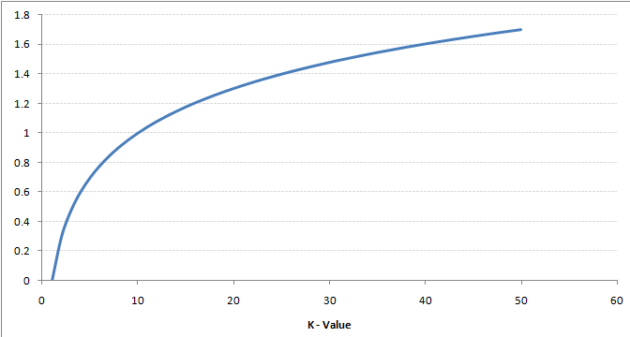
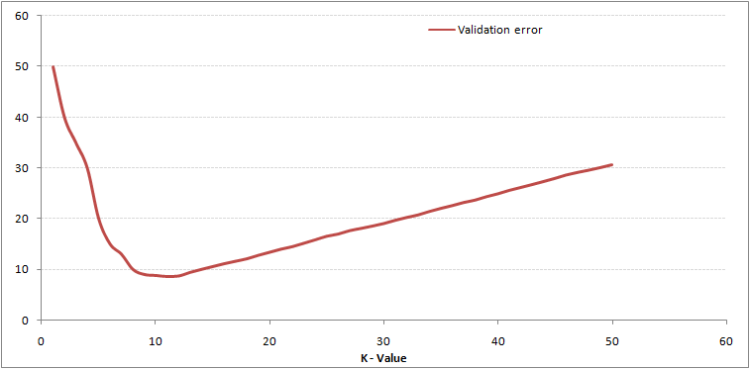
How to choose the optimum value of k
Training error rate vs K
Validation error rate vs K
To get the optimal value of K, you can segregate the training and validation from the initial dataset
Now plot the validation error curve to get the optimal value of K
This value of K should be used for all predictions

Slide 12
Pros and Cons of KNN
Advantages
Not impacted by Outliers
Makes no assumptions about distributions of classes in feature space
Disadvantages
Fixing the optimal value of K is a challenge
Does not output any models. Calculates distances for every new point

Slide 13
Industry applications of kNN
Pattern recognition in Optical character recognition
Concept search in semantic models in NLP
Detect similar buying patterns in customer analytics
Text classification

Slide 14
Hands on exercise on KNN
The dataset used here is Breast Cancer Wisconsin data (https://www.kaggle.com/uciml/breast-cancer-wisconsin-data)
Some important functions
1. Importing Libraries
import pandas as pd
import seaborn as sns
import numpy as np
2. Assigning Kneighbour
NNH = KNeighborsClassifier(n_neighbors= 5 , weights = 'distance' )

Slide 15
Hands on exercise on KNN
3. Recognise the data types of each variables
bc_df['diagnosis'] = bc_df.diagnosis.astype('category')
bc_df.dtypes
4. Summary of the dataset
bc_df.describe().transpose()
5. Create a separate dataframe consisting only of the features i.e independent attributes
bc_feature_df = bc_df.drop(labels= "diagnosis" , axis = 1)
bc_feature_df.head()

Slide 16
Hands on exercise on KNN
6. Split X and y into training and test set in 75:25 ratio
X_train, X_test, y_train, y_test = train_test_split(X, y, test_size=0.30, random_state=1)
7. Call Nearest Neighbour algorithm
NNH.fit(X_train, y_train)
8. For every test data point, predict it's label based on 5 nearest neighbours in this model. The majority class will be assigned to the test data point
predicted_labels = NNH.predict(X_test)
NNH.score(X_test, y_test)

Slide 17
Case Study
Context:
The dataset to be audited was provided which consists of a wide variety of intrusions simulated in a military network environment It created an environment to acquire raw TCP/IP dump data for a network by simulating a typical US Air Force LAN. The LAN was focused like a real environment and blasted with multiple attacks. For each TCP/IP connection, 41 quantitative and qualitative features are obtained from normal and attack data (3 qualitative and 38 quantitative features) .
The class variable has two categories:
• Normal
• Anomalous

Slide 18
Dataset Info
Dataset:
https://www.kaggle.com/what0919/intrusion-detection
Data basically represents the packet data for a time duration of 2 seconds.
1-9 Columns: basic features of packet (type 1)
10-22 columns: employ the content features (type 2)
23-31 columns: employ the traffic features with 2 seconds of time window (type 4)
32-41 columns: employ the host based features

Slide 19
Objective and Steps
To detect Network Intrusion using KNN
Steps:
Import Libraries and Data
Data Preparation and analysis(standardization)
Split the dataset into training and test datasets
Build the model and train and test on training and test sets respectively using scikit-learn. Print the Accuracy of the model with different values of k=3,5,9.
Cross Validation

Slide 20


Questions?

